Slide 1

On Becoming a Leader in Risk Management
Fundamentals of RM
RM System and Process
Leadership in RM
Incident Investigation
RM Tools & Challenges
RM in Industry
People & Org.
Application & Perspectives
ENGG404 - Lecture
Case 4: The UCIL Bhopal Loss Incident (1984)
1

Slide 2
Learning Outcomes
Critique the actions of senior leadership (or lack thereof) in a multinational organization which manages significant risks within its global operations.
Argue in favour of the need for senior leadership accountability as demonstrated by tangible actions.
Articulate why post incident (emergency) response needs to be considered for risk management & during incident investigation.
Case 4: The Bhopal Loss Incident
2
Notes:
2

Slide 3
Introduction & Key Lesson
The case study of the Bhopal incident illustrates why we must maintain a relentless focus on risk management throughout the life of a facility (design, build, operate, decommission).
While line management is responsible for the safety of facilities, Senior Leadership is accountable for making sure these responsibilities are being fulfilled!
Trust but verify!
You are only as good as your weakest link.
Case 4: The Bhopal Loss Incident
3
Notes:
3

Slide 4
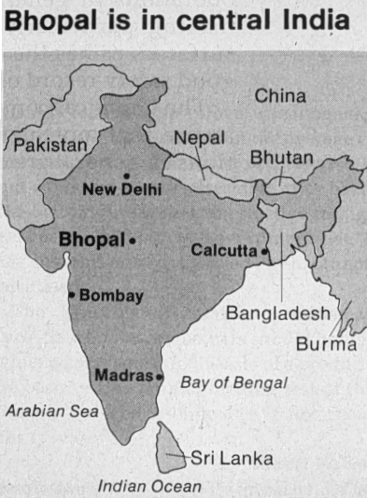
Background
Bhopal is a large central India city, the Madhya Pradesh state capital.
1961 population: 102,000
1973 population: 250,000
1981 population: 896,000
1985 population: 1,002,000
Much of this growth came from migration from surrounding rural areas.
Many migrants could not afford city housing and became squatters, creating slums and shantytowns.
By 1984, Bhopal had 156 slum colonies.
2011 population: 1,796,000
Reprinted with permission from Chem. Eng. News, 62(50), p. 6. Copyright 1984 American Chemical Society.
Case 4: The Bhopal Loss Incident
4
Notes:
4

Slide 5
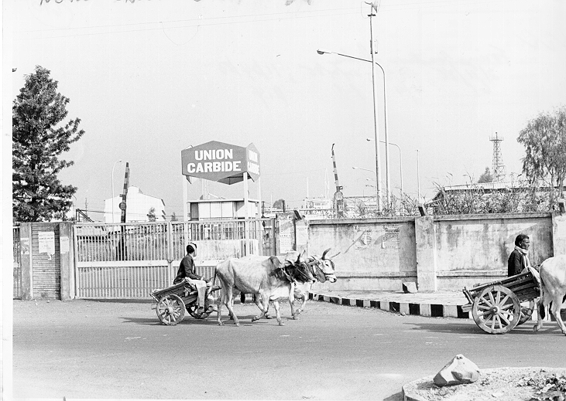
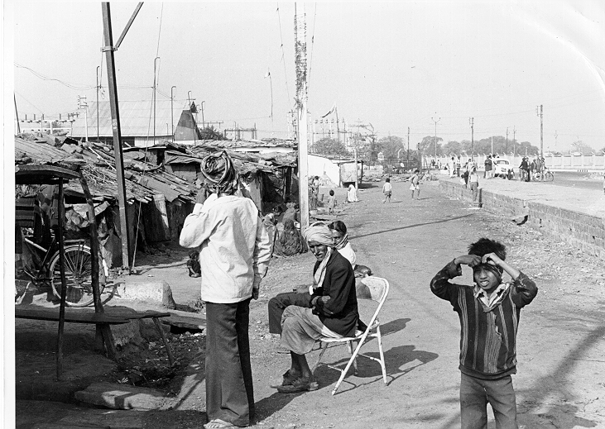
Background
The Union Carbide plant located in Bhopal was owned by Union Carbide (India) Ltd., or UCIL. Union Carbide Corporation held 50.9% of the shares of UCIL. The government of India owned ~25%, and 24,000 other shareholders owned the remainder.
Two slums were located very near the UCIL plant, in an area not zoned for residential use. The plant fence-line can be seen in the upper right.
Case 4: The Bhopal Loss Incident
5
Notes:
5

Slide 6
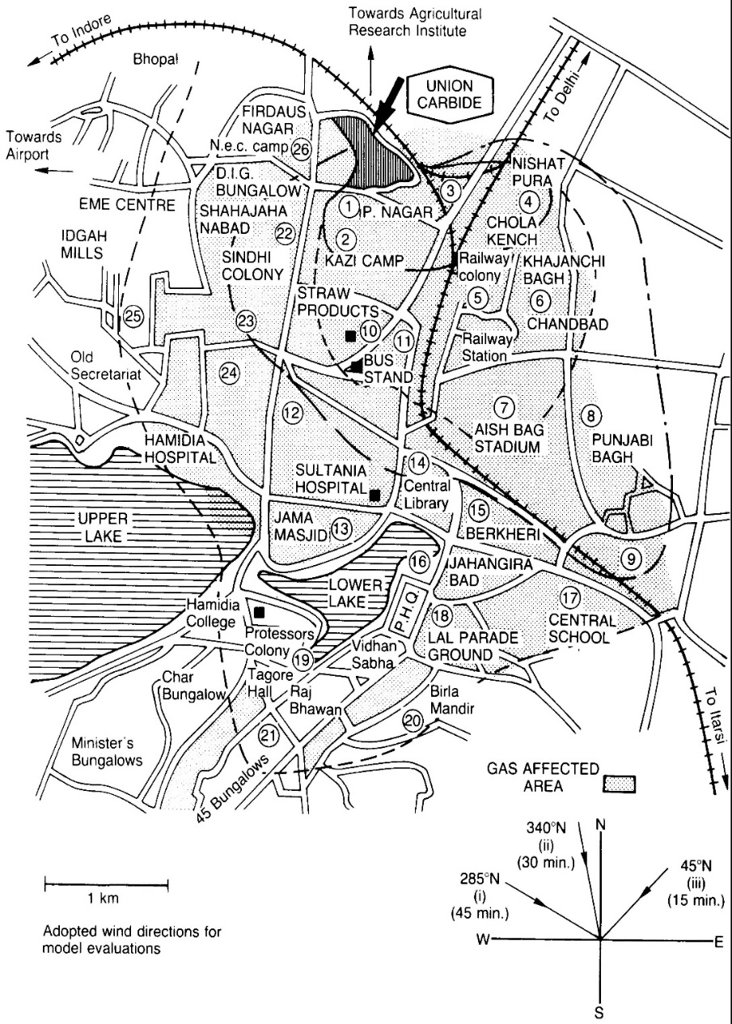
Background
When the UCIL plant was first built, it was situated in an industrial area with no residential areas nearby.
Because the slums built up around the plant over time, many thousands of people were exposed to a cloud of MIC when it was released from the plant in 1984.
Factors contributing to the severity of consequences included MIC vapors being heavier than air, the release occurring at night when dispersion is less, and hospitals and dispensaries being unable to cope with the number of victims.
Reprinted from J Haz Matls 17, M.P. Singh and S. Ghosh, "Bhopal Gas Tragedy: Model Simulation of the Dispersion Scenario,” p.1, © 1987, with permission from Elsevier
Case 4: The Bhopal Loss Incident
6
Notes:
6

Slide 7
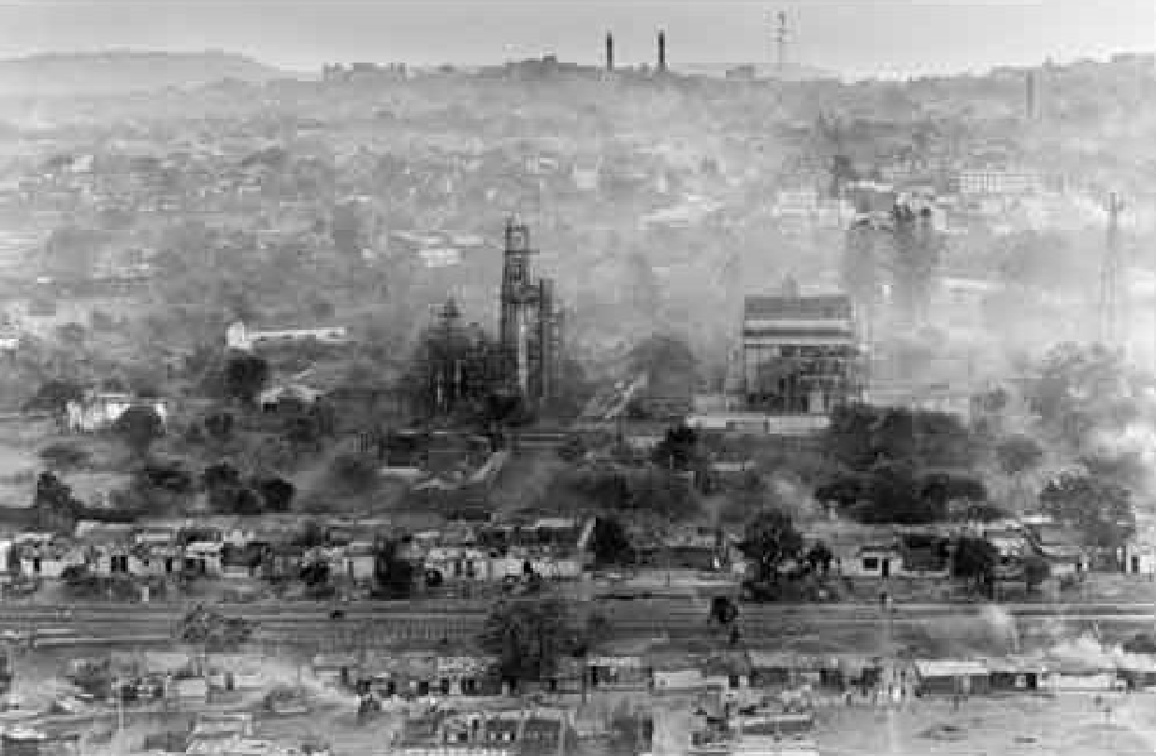
What Happened:
Bhopal, India, at 12:40 AM (early morning hours) 3-Dec-1984 (12:10 PM MDT, Sunday December 2nd)
A vapour cloud of Methyl Isocyanate (MIC), a highly toxic substance, was released in an uncontrolled manner.
Case 4: The Bhopal Loss Incident
7
Notes:
7

Slide 8
Key Points of the Loss Incident
MIC hazards - not widely understood before incident; MIC conveniently stored at site, an intermediate chemical used to make pesticide
A change in the plant operating conditions: MIC - Temp & Press increased
Scrubber vent stack gas plume (emergency flare was shutdown)
Workers took emergency action:
Tried switching on refrigeration - had been shut off
Started the scrubber on the stack - had been shut off
Sprayed water on escaping gases - had been shut off
Toxic gases were able to bypass all these process safety / pollution control / mitigation features (loss of control, process safety loss incident)
Approx. 40,000 kgs. MIC gas escaped as a "heavy" cloud over 45 minutes
Two large residential shantytowns were allowed by the City Council to be built with no consideration of risk
In the panic of the night, over 100,000 people urged to flee
Impact on People:
Only 1 worker affected at the plant site
Offsite: both acute & longer term health impacts
Initially 2,500 fatalities (more like 20,000 & over 100,000 with reduced life expectancy)
Case 4: The Bhopal Loss Incident
8
Notes:
8

Slide 9
Organizational Factors
Plant losing money, running at 40% capacity
Best employees leaving, 80% of workers training in USA had left
Between 1980 and 1984, staffing cut by half
UCIL was one of fifty international subsidiaries of The Union Carbide Corporation; UCIL = 2% of world sales, 2% of profits
The plant was for sale at time of disaster due to economic conditions
8 plant managers in 15 years
Original managers had left and had been replaced by others whose experience had been mainly in the manufacture of consumer batteries.
Case 4: The Bhopal Loss Incident
9
Notes:
9

Slide 10
A Brief Summary of Causes
Immediate Causes (sub-std conditions, sub-std practices):
Water mixed with MIC
The actual cause of mixing remains in dispute
Basic Causes (Engineering and Design Factors, Job Factors, Personal Factors):
Relating to the Release: Tank integrity
Relating to Mitigation (preventing release, or reducing impact of release): inadequate engineering controls (pressure containment, scrubber, flare, refrigeration system; possible egress of water into MIC storage tank)
Relating to the Exposure: encroachment, lack of response
Latent Causes (Weaknesses in which RMS Elements?):
Let’s explore this area further…
Case 4: The Bhopal Loss Incident
10
Notes:
10

Slide 11
Discussion on RMS Elements (Latent Causes)
# 3 Community Awareness and Emergency Preparedness:
Bhopal illustrated deficiencies in the procedures for handling emergencies, both by the company and by the local authorities.
It showed the need for companies to collaborate with the community emergency services to identify incidents that might occur and their consequences, drawing up plans to cope with them and exercising these plans – sounds like good risk management!
#10 Employee Competency & Training:
Building and maintaining the competency of employees in operating the process safety systems was clearly inadequate as these systems were out-of-operation all at the same time.
Similarly, senior managers were unaware of the hazards of MIC, and had not understood the purpose of these process safety systems in controlling the hazards of MIC.
Others: #2 RAMR, #4 MOC, #5 IRIAA, #6 PECI
Case 4: The Bhopal Loss Incident
11
Notes:
11

Slide 12
Discussion on RMS Elements (Latent Causes)
#6 Program Evaluation and Continuous Improvement:
This element is perhaps the second most effective element.
The successful implementation of this element – the inspection and auditing of the effective implementation of other elements within the risk management system and program – would have revealed the weaknesses in RMS Els #1, #2, #3, #4, #5, and #10, and would have driven senior management to take action to correct.
Even though local Indian management is responsible for such activities, as a subsidiary of UCC, senior management at UCC is accountable and must ensure that these activities are actually being executed.
And to do so, even with today’s available technologies for remote teleconferencing, auditing must be carried out by a team of “boots on the ground” auditors.
Trust but verify!
As we will see in a subsequent lecture, audits require the full cycle of PDCA, especially “act” on any deficiencies found.
Case 4: The Bhopal Loss Incident
12
Notes:
12

Slide 13
Summary & Key Lessons:
We must maintain an unwavering commitment to risk management throughout the life of a facility, despite competing objectives and other challenges (economic constraints, low commodity prices, boom / bust cycles, etc.). RMS El. #1 MLCA
The Bhopal Tragedy was the result of a breakdown in process safety management, RMS El. #2 RA&MR, coupled with a degradation in competencies at all levels within the organization, RMS El. #9 EC&T, and a disregard for community development and planning. RMS El. #3 CA&EP
While line management is responsible for the safety of facilities, senior leadership is accountable for making sure these responsibilities are being fulfilled! RMS El. #6 PECI
Case 4: The Bhopal Loss Incident
13
Notes:
13

